Slide 1
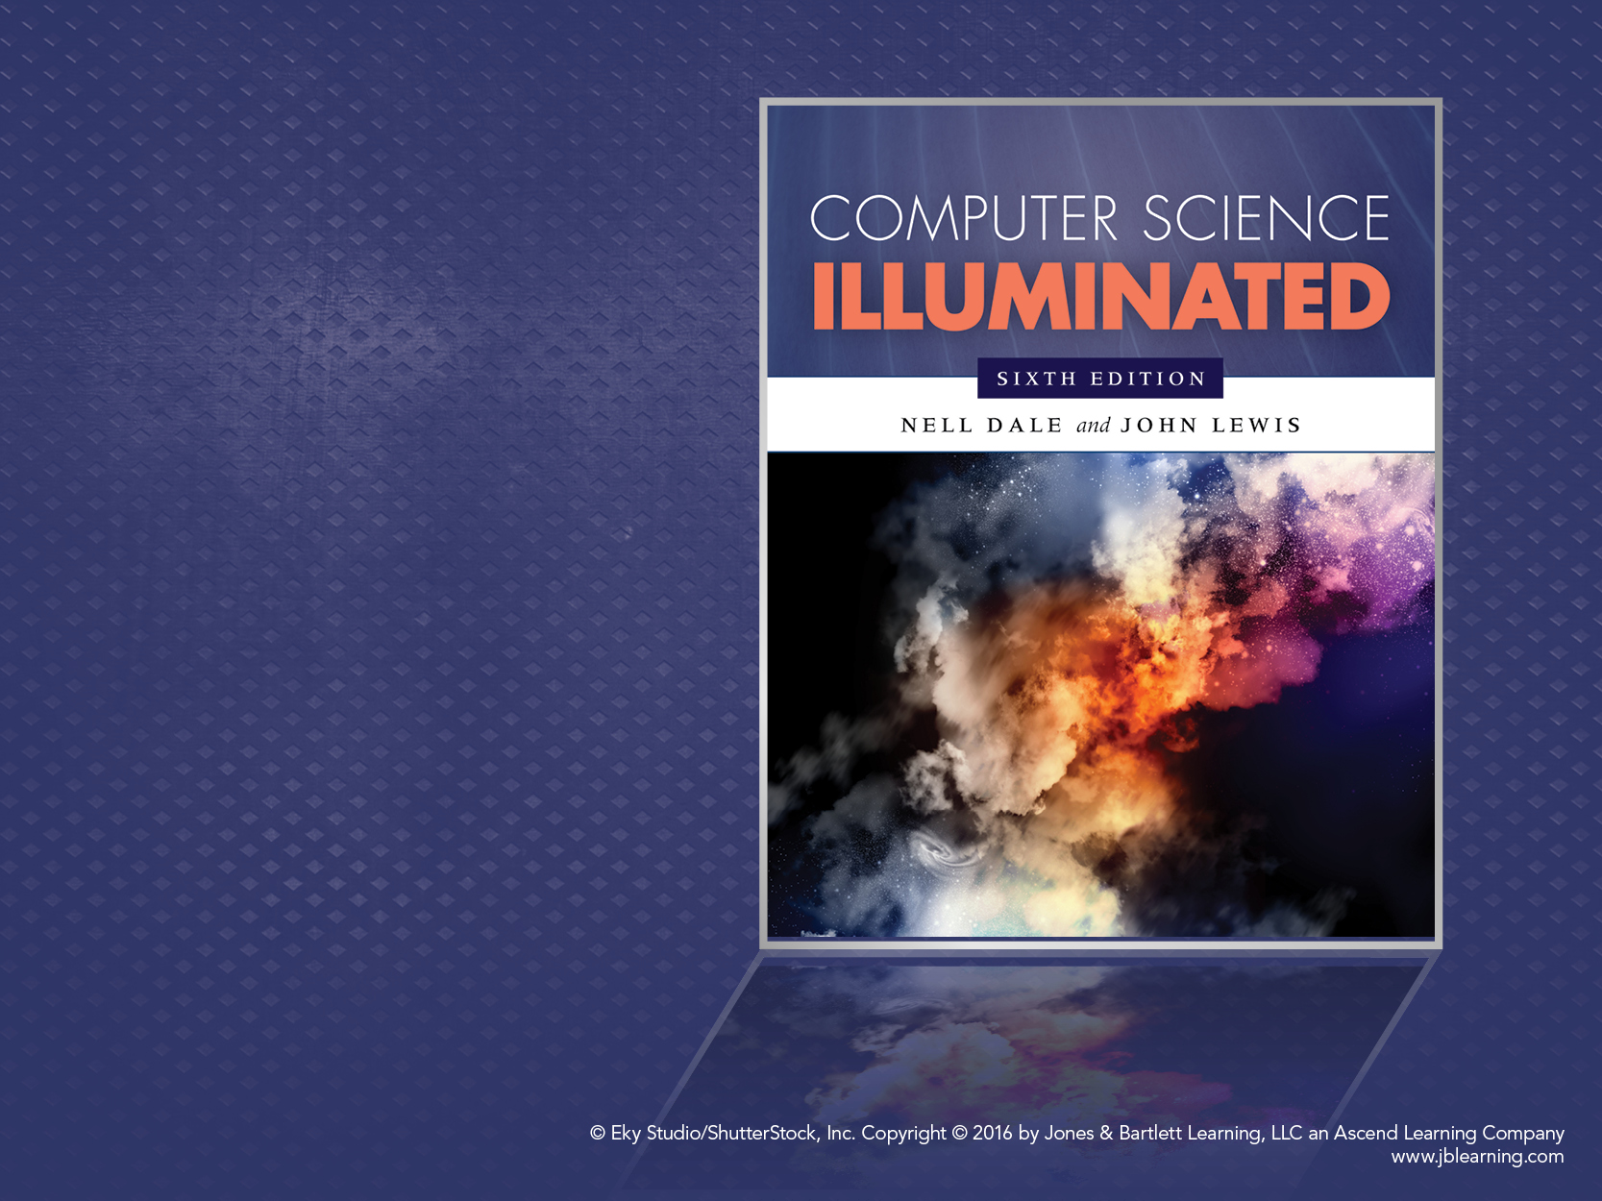
Chapter 5
Computing Components

Slide 2
Chapter Goals
  Read an ad for a computer and understand the jargon
  List the components and their function
  in a von Neumann machine
  Describe the fetch-decode-execute cycle of the von Neumann machine
  Describe how computer memory is organized and accessed

Slide 3
Chapter Goals
Name and describe different auxiliary storage devices
Define three alternative parallel computer configurations
Explain the concept of embedded systems and give examples from your own home

Slide 4
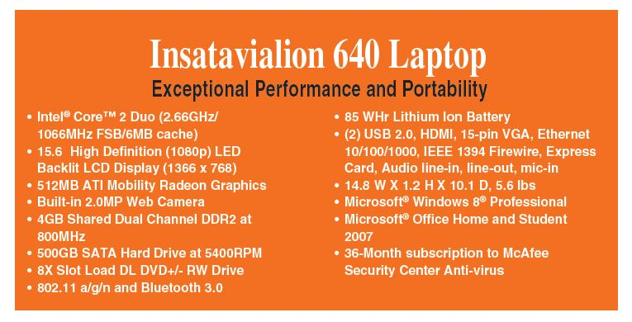
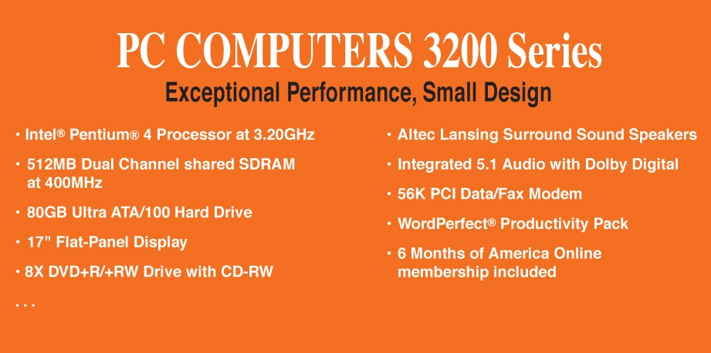
Computer Components
Consider the following ad:

Slide 5
Computer Components
What does all this jargon mean?
Intel® Core™ 2 Duo (2.66GHz/1066Mhz
FSB/6MB cache)
4GB Shared Dual Channel DDR2 at 800 MHz
500 GB SATA Hard Drive at 5400RPM
15.6” High Definition (1080p) LED Backlit
LCD Display (1366 x 768)
8X Slot Load DL DVD+/- RW Drive
14.8”W X 1.2”H X10.1” D, 5.6 lbs.
Be patient!
If you don't
know now, you
should know
shortly

Slide 6
Computer Components (continued)
512 MB ATI Mobility Radeon Graphics
85 WHr Lithium Ion Battery
(2) USB 2.0, HDMI, 15-Pin VGA, Ethernet 10/100/1000 IEEE 1394 Firewire, Express Card, Audio line-in, line-out, mic-in
Microsoft® Windows 7® Professional
Microsoft® Office Home and Student 2007
36-Month subscription to McAfee Security Center Anti-virus

Slide 7
Sizes in Perspective
Admiral Grace Murray Hopper’s Illustration
  A coil of wire nearly 1,000 feet long
    Distance traveled by an electron along the wire
    in the space of a microsecond
  A short piece of wire
    In the space of a nanosecond
  A bag containing grains of pepper
    In the space of a picosecond

Slide 8
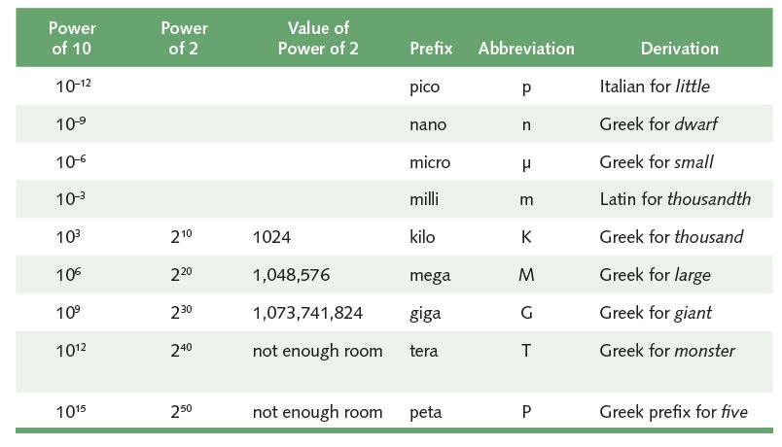
Sizes in Perspective
Powers of 10 for time, powers of 2 for storage
What is a Hertz?

Slide 9
Sizes in Perspective
Intel Processor
speed 2.66 GHz
SDRAM
size 4GB
speed 800 MHz
500GB SATA at 5400 RPM
Transfer rate 300MB per second
Flat screen dot pitch .28mm
To which do these
apply?
Bigger is better
Faster is better
Smaller is better

Slide 10
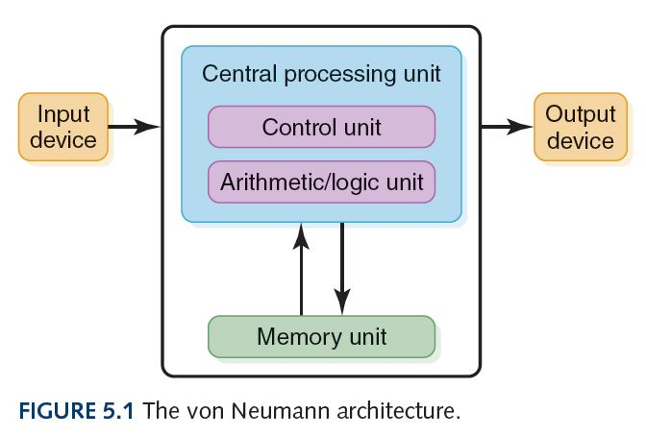
Stored-Program Concept
Instructions and data both stored in memory unit

Slide 11
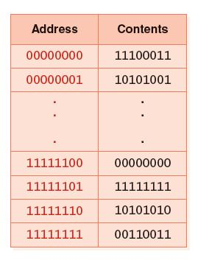
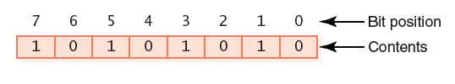
Memory
Memory
A collection of cells, each with a unique physical address
Most computers are byte-addressable
Cell at address 11111110 contains 10101010
“Little endian” bit numbering:

Slide 12
Memory
Memory
What does 10101010 mean?
No way to answer that
Could be an instruction, a natural number, a signed integer, a character, part of an image, …

Slide 13
Arithmetic/Logic Unit
Performs basic arithmetic operations such as addition and subtraction
Performs logical operations such as AND, OR, and NOT
Most modern ALUs have a small amount of special storage units called registers that can be accessed faster than main memory

Slide 14
Input/Output Units
Input Unit
A device through which data and programs from
the outside world enter the computer system;
Can you name three?
Output unit
A device through which results stored in the
computer memory are made available outside the computer system
Can you name two?

Slide 15
Control Unit
Control unit
The organizing force in the computer
Instruction register (IR)
Contains the instruction that is being executed
Program counter (PC)
Contains the address of the next instruction to be
executed
Central Processing Unit (CPU)
ALU and the control unit called the Central Processing Unit, or CPU

Slide 16
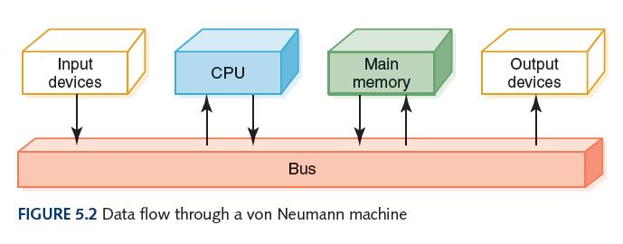
Flow of Information
Bus
In general: A communication system that transfers data between components inside a computer or between computers; the medium (wires, optical fiber, etc.) and the protocols (rules for sharing the medium nicely)
“The” bus: Connects the CPU, main memory, I/O devices, and possibly other components (e.g. hard disk drive)

Slide 17
What is an N-bit Processor?
It could mean any of these:
N-bit general registers
N-bit ALU
N-bit addresses
N-bit data bus

Slide 18
The Fetch-Execute Cycle
Fetch the next instruction
Decode the instruction
Get data if needed
Execute the instruction
Why is it called a cycle?

Slide 19
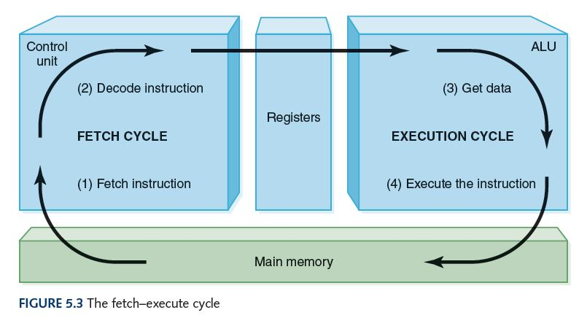
The Fetch-Execute Cycle

Slide 20
RAM and ROM
Random Access Memory (RAM)
Memory in which each location can be accessed and changed
Read Only Memory (ROM)
Memory in which each location can be accessed but not changed
RAM is volatile, ROM is not
What does volatile mean?

Slide 21
Secondary Storage Devices
Why is it necessary to have secondary storage devices?
Can you name some of these devices?

Slide 22
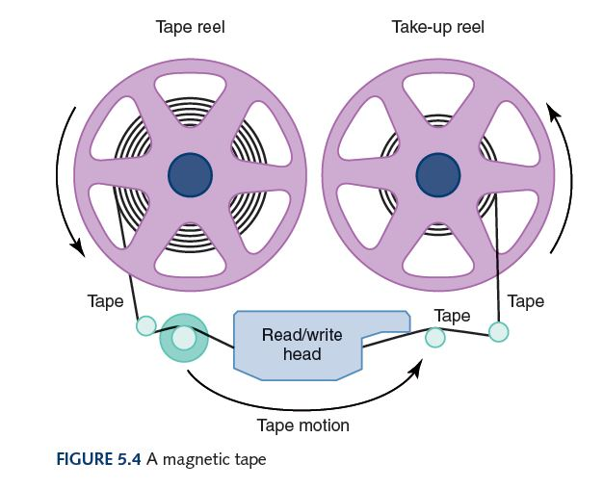
Magnetic Tape
The first truly mass auxiliary storage device was the magnetic tape drive
Tape drives have a
major problem; can
you describe it?

Slide 23
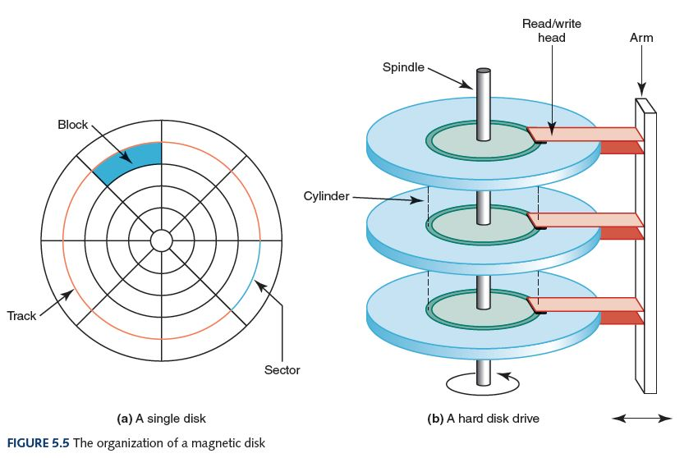
Magnetic Disks

Slide 24
Magnetic Disks
Seek time
Time for read/write head to be over right track
Latency
Time for sector to be in position
Access time
Can you define it?
Transfer rate
Rate at which data moves from the disk to memory

Slide 25
Optical Disks
CD
A compact disk that uses a laser to read information stored optically on a plastic-coated disk; data is evenly distributed around spiral track
CD-ROM read-only memory
CD-DA digital audio
CD-WORM write once, read many
RW or RAM both read from and written to
DVD
Digital Versatile Disk, used for storing audio and video
Blu-ray
Higher capacity DVD allowing higher resolution video, etc.

Slide 26
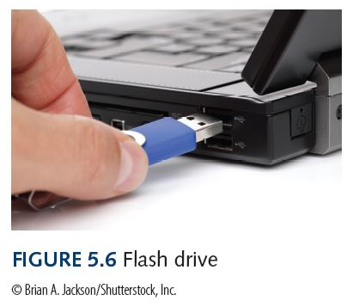
Flash Drives
Flash Memory
Nonvolatile
Can be erased and rewritten
Supports USB mass storage standard

Slide 27
Touch Screens
Touch screen
A computer monitor that can respond to the user, touching the screen with a stylus or finger
There are four types
  Resistive
  Capacitive
  Infrared
  Surface acoustic wave (SAW)

Slide 28
Touch Screens
Resistive touch screen
A screen made up of two layers of electrically conductive material
  One layer has vertical lines, the other has horizontal lines
  When the top layer is pressed, it comes in contact with the second layer which allows electrical current to flow
  The specific vertical and horizontal lines that make contact dictate the location on the screen that was touched

Slide 29
Touch Screens
Capacitive touch screen
A screen made up of a laminate applied over a glass screen
  Laminate conducts electricity in all directions; a very small current is applied equally on the four corners
  When the screen is touched, current flows to the finger or stylus
  The location of the touch on the screen is determined by comparing how strong the flow of electricity is from each corner

Slide 30
Touch Screens
Infrared touch screen
A screen with crisscrossing horizontal and vertical beams of infrared light
  Sensors on opposite sides of the screen detect the beams
  When the user breaks the beams by touching the screen, the location of the break can be determined

Slide 31
Touch Screens
Surface acoustic wave (SAW)
A screen with crisscrossing high frequency sound waves across the horizontal and vertical axes
  When a finger touches the surface, corresponding sensors detect the interruption and determine location of the touch

Slide 32
Embedded Systems
Embedded systems
Computers that are dedicated to perform
a narrow range of functions as part of a
larger system
Empty your pockets or backpacks.
How many embedded systems do you have?

Slide 33
Parallel Computing
Four general forms:
Bit-level parallelism
  Bits can be processed simultaneously
  Ex: Increasing word size
Instruction-level parallelism
  Instructions can be executed simultaneously
  Ex: Pipelining (overlapping instructions)
  Ex: Superscalar (multiple execution units)
Data-level parallelism
  Data subjected to same operation sequence simultaneously
  Ex: Calculation of all student’s GPAs simultaneously
Task-level parallelism
  Entire tasks can be completed simultaneously
  Ex: Google servers – simultaneous independent searches
  Ex: “Pipelined” processors

Slide 34
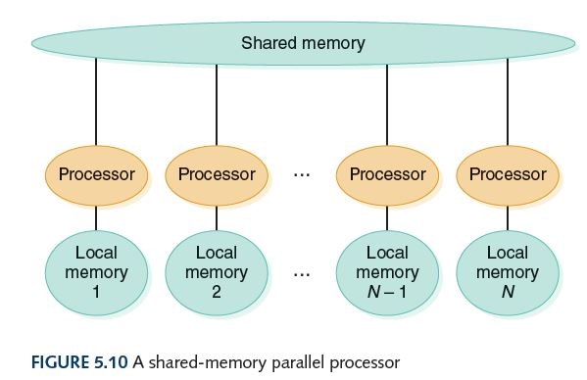
Shared Memory
Parallel Processor
Communicate through shared memory

Slide 35
Ethical Issues
Is Privacy a Thing of the Past?
  What does Austin Bay say about the printing press? The camera? The telegraph? The telephone?
  Do you agree that personal privacy is “all but dead and gone”?
  What, if anything, needs to be done about it?
  What does Bay say about the future of institutional and state secrecy?

Slide 36
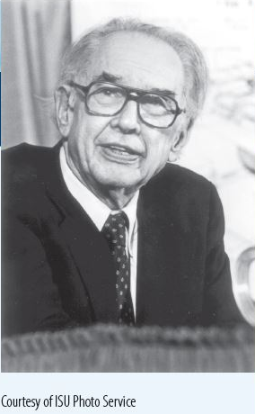
Who am I?
A lawsuit
determined my
legacy.
What
was it all about?

Slide 37
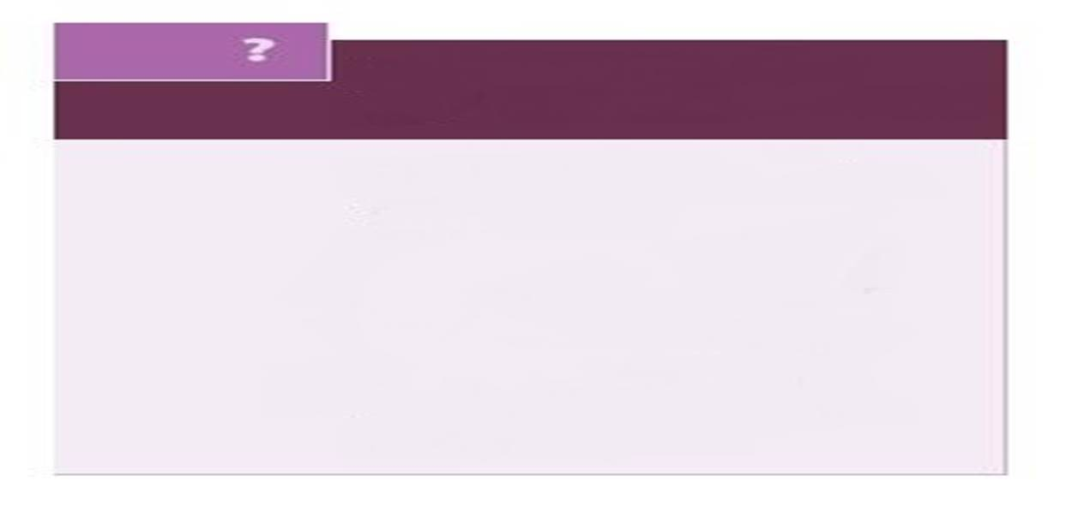
Do you know?
Maurice Wilkes made what far-reaching Discovery within six weeks of beginning to program?
What was stolen at Target during the 2013 Christmas shopping season?
Bush received 4,258 votes and Kerry received 260 votes, out of 638 votes cast. ???
Why have spies infiltrated the fantasy world of virtual games?
What did President Obama refuse to give up?

